Slide 1


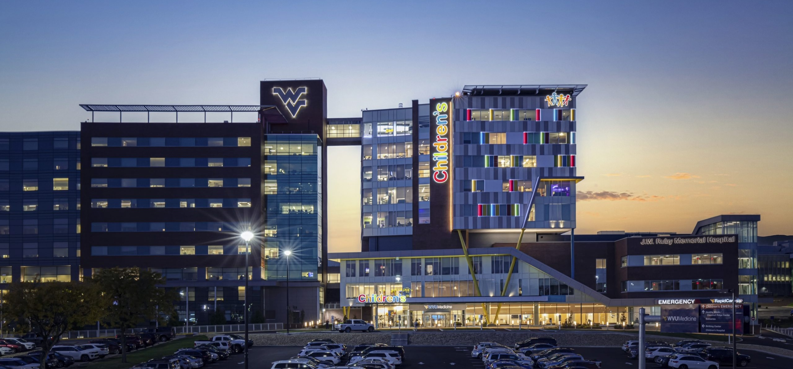
WVU MEDICINE DIRECT-TO-EMPLOYER OPPORTUNITY
October 22, 2024

Slide 2



Founded in 1979 and headquartered in Indianapolis, IN​
Full-service TPA specializing in the administration of self-funded health plans and population health management​
One of the country’s largest independently-owned TPAs
The Key Family is a commonly-held group of benefits related organizations with:​
3,000+ corporate clients​
3.0 million members under management​
700 Employees
Exclusive Relationships
We know The Market – Agents, Networks, and MGAs

Slide 3


Market Leader in Private Labeled DTE Plans
Louisville, KY
OneHealth Plan
Cincinnati, OH
TCH Optimal
Bentonville, AR
Northwest Health Plan
Knoxville, TN
East Tennessee Health Plan
Meridian, MS
Affinity Health Plan
Fort Myers, FL
Lee Health Care Partners

Slide 4
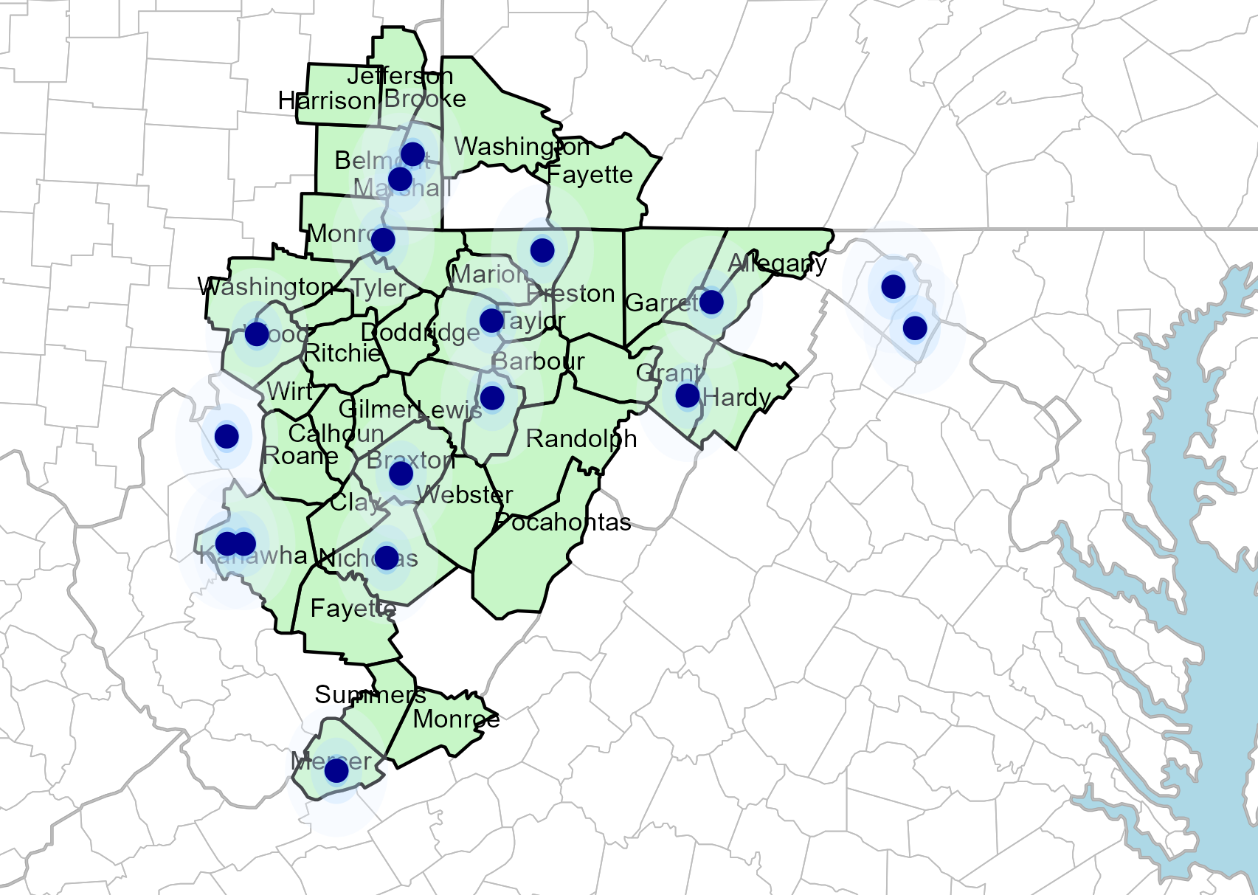
Significant Opportunity for Plan Growth
Target Market 900+ Employers 120,000+ Employees 190,000+ Members
 | Employer Size Group (# of Employees)
Commercial Employers With Headquarters | 50-100 | 101-200 | 201-400 | 401-1,000 | 1,001-3,000 | 3,000+
In Catchment Area | 635 | 286 | 195 | 84 | 33 | 12
Total Employees at Employers | 50-100 | 101-200 | 201-400 | 401-1,000 | 1,001-3,000 | 3,000+
Headquartered in Catchment Area | 47,625 | 42,900 | 58,500 | 58,800 | 66,000 | 72,000
Total Members with Employers | 50-100 | 101-200 | 201-400 | 401-1,000 | 1,001-3,000 | 3,000+
Headquartered in Catchment Area | 56,198 | 50,622 | 69,030 | 69,384 | 77,880 | 84,960
Researched for Lewis, Allegany, Clay, Garrett, Washington, Belmont, Fayette, Harrison, Jefferson, Marion, Monroe, Mercer, Bland, Barbour, Berkeley, Braxton, Brooke, Calhoun, Doddridge, Gilmer, Grant, Hardy, Kanawha, McDowell, Marshall, Mineral, Monongalia, Nicholas, Ohio, Pleasants, Pocahontas, Preston, Randolph, Ritchie, Roane, Summers, Taylor, Tucker, Tyler, Upshur, Webster, Wetzel, Wirt, and Wood Counties

Slide 5
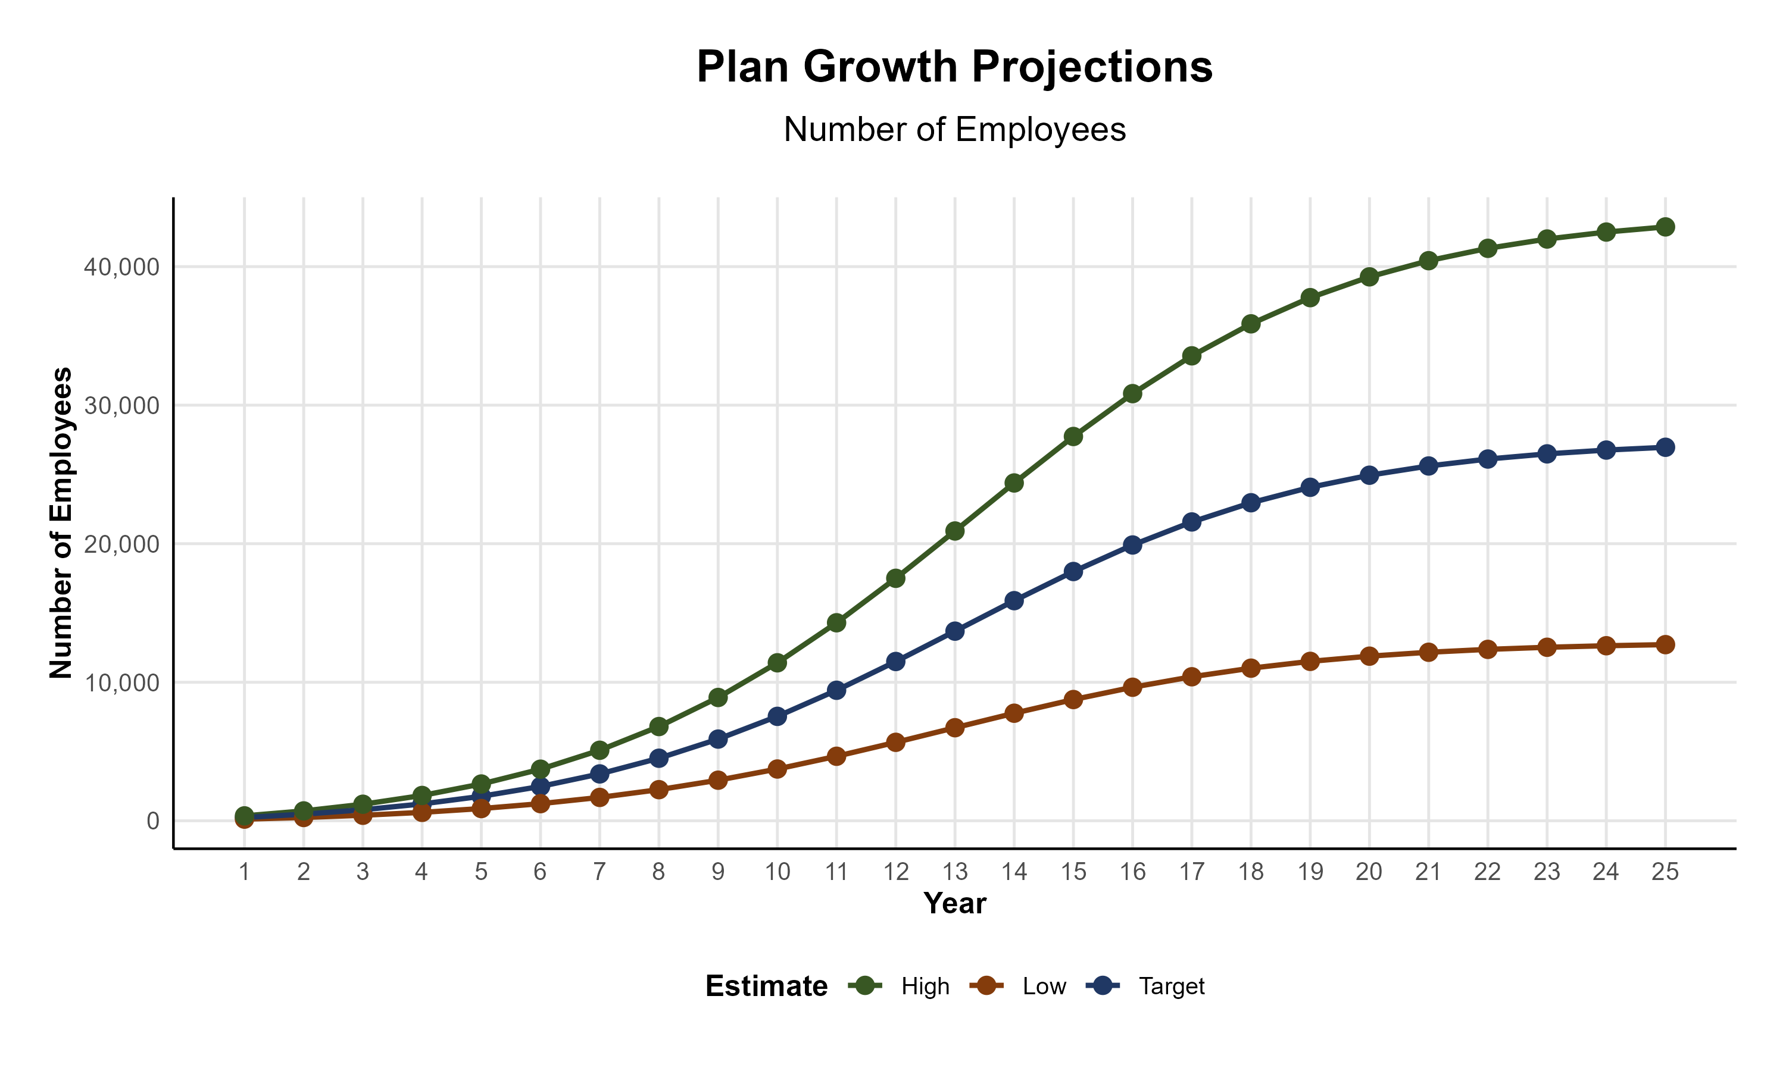
Plan Potential Growth Paths
Self Funded
358K
PLAN GROWTH POTENTIAL
751K
Insured
Working Age
1,172K
Population
2,063K
Estimates include Allegany, Garrett, Washington, Belmont, Harrison, Jefferson, Monroe, Fayette, Bland, Barbour, Berkeley, Braxton, Brooke, Calhoun, Clay, Doddridge, Gilmer, Grant, Hardy, Kanawha, Lewis, McDowell, Marion, Marshall, Mercer, Mineral, Monongalia, Nicholas, Ohio, Pleasants, Pocahontas, Preston, Randolph, Ritchie, Roane, Summers, Taylor, Tucker, Tyler, Upshur, Webster, Wetzel, Wirt, and Wood Counties

Slide 6

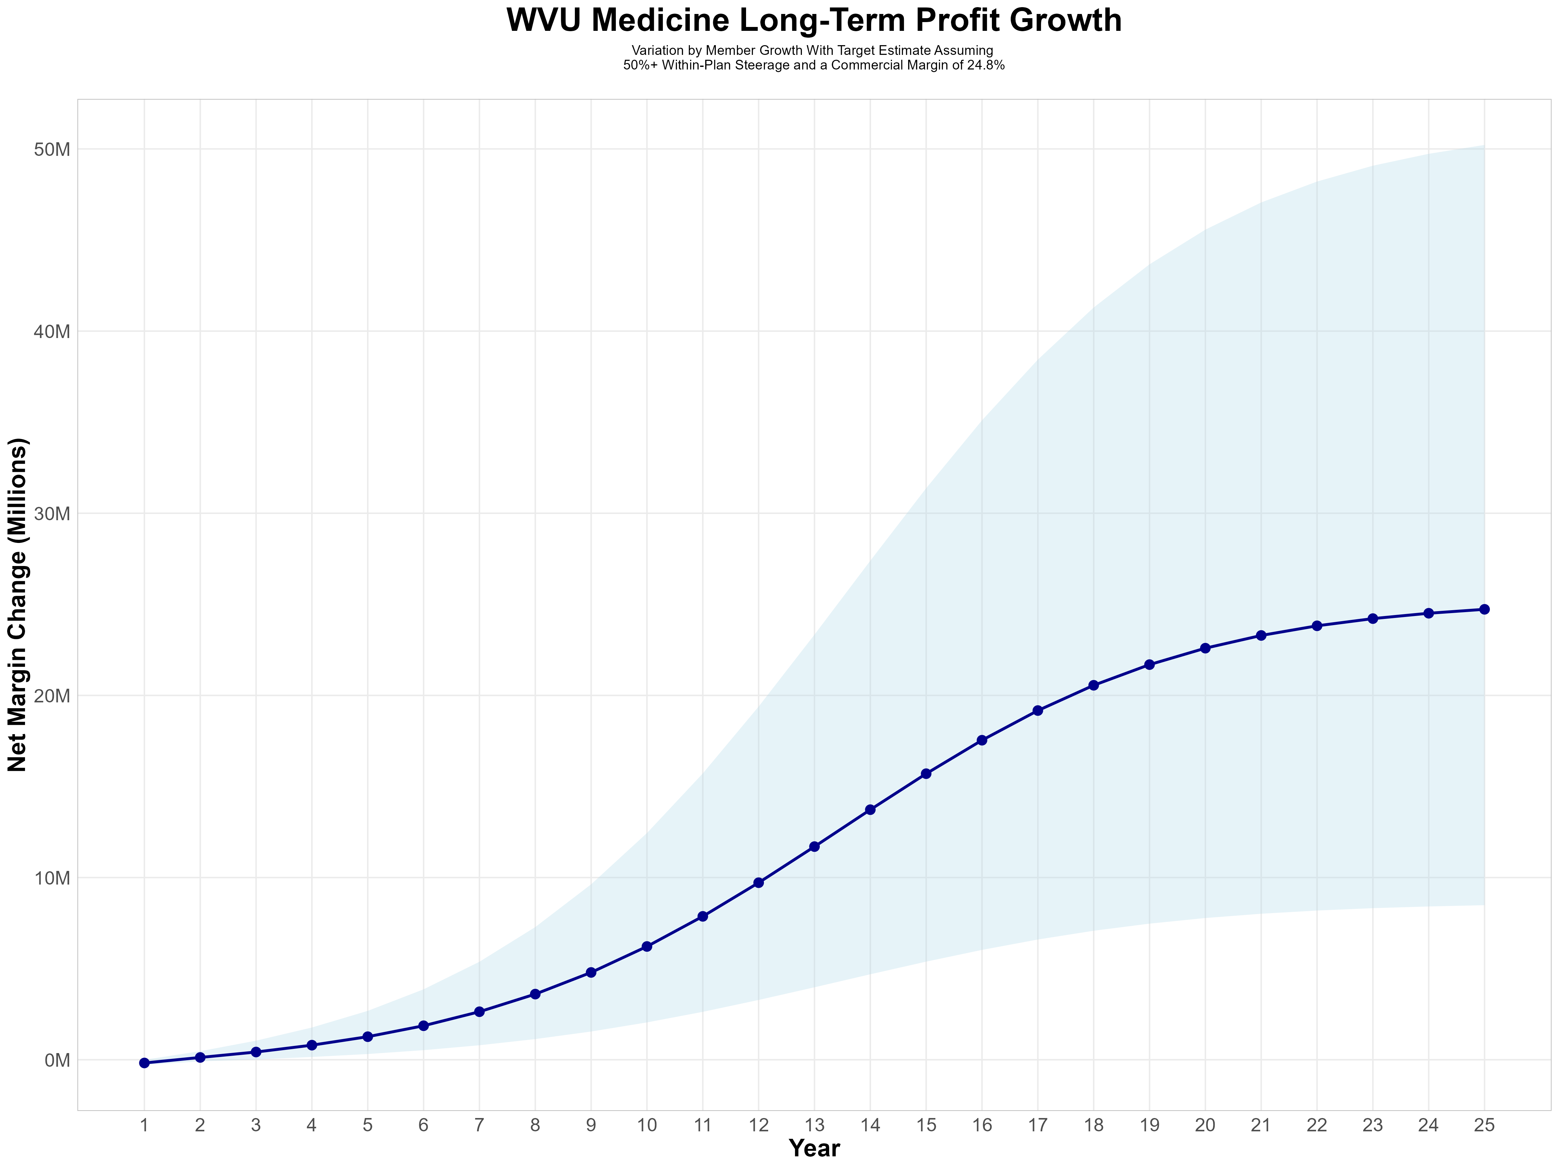
Growing Powerful, Lasting Profitability
Early Stage
Gaining Name Recognition, Early Growth
New Revenue:
New Profit:
$5.93M
$1.32M
Growth Stage
Strong Reputation, Strong Growth
New Revenue:
New Profit:
$43.48M
$10.91M
Mature Stage
High Profitability, Market Saturation
New Revenue:
New Profit:
$89.96M
$22.73M

Slide 7
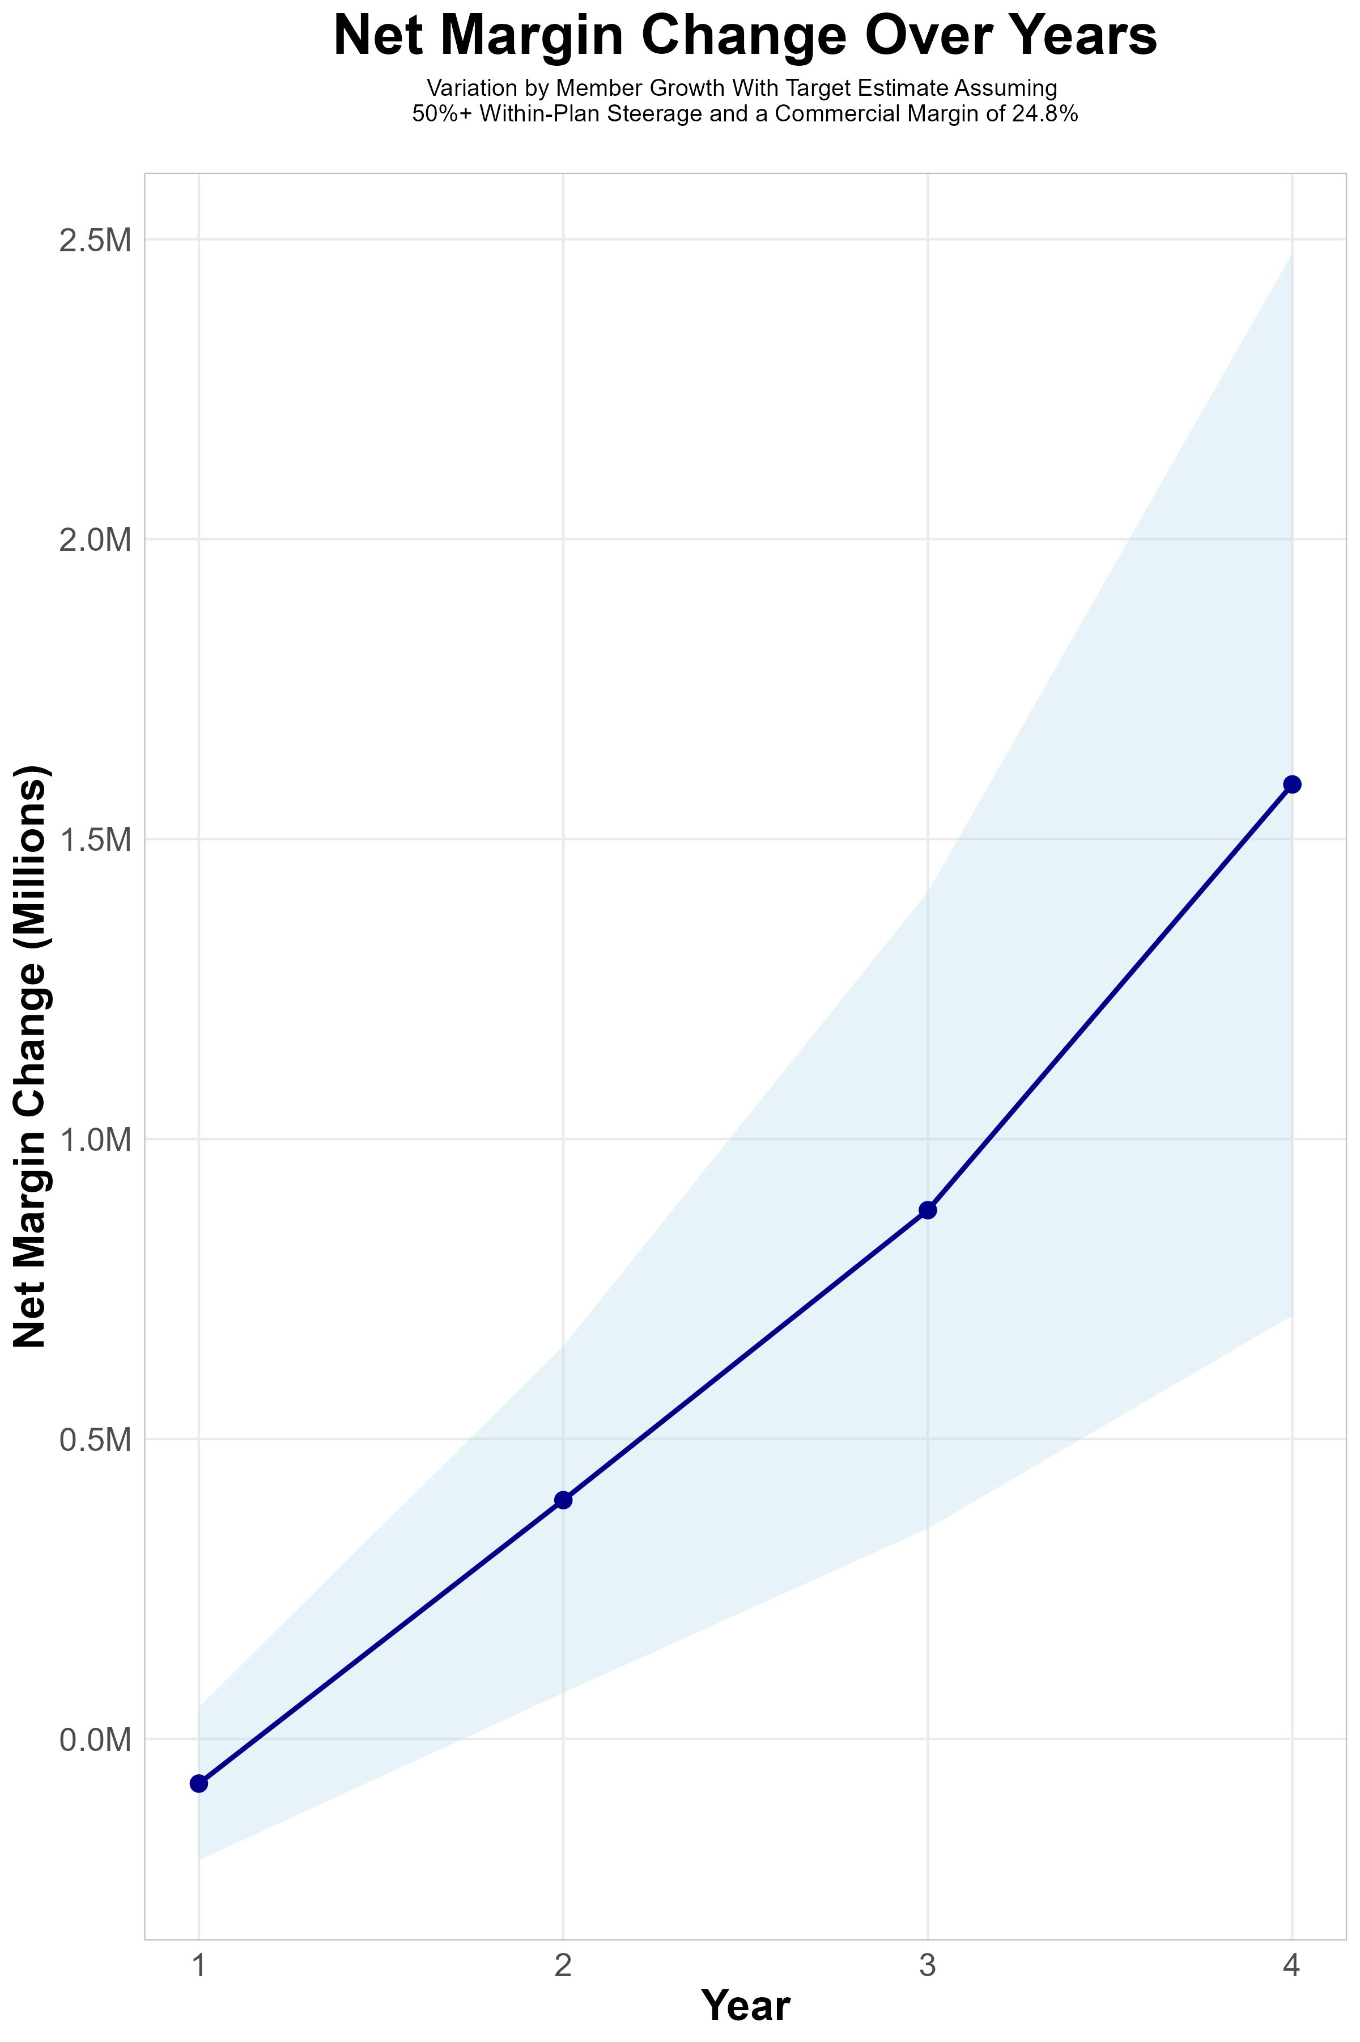
FOUR-YEAR PROJECTIONS
Target Member Growth | Target Member Growth | Target Member Growth | Target Member Growth | Target Member Growth
Metric | Year 1 | Year 2 | Year 3 | Year 4
Number of Members | 400 | 900 | 1,400 | 2,200
Incremental Margin | 250.7K | 567.2K | 1,044.6K | 1,744.7K
Network Access Fee | 4.8K | 10.8K | 16.8K | 26.4K
Implementation Fee (One-Time) | -150.0K | 0.0K | 0.0K | 0.0K
Sales and Marketing Costs | -180.0K | -180.0K | -180.0K | -180.0K
Net Margin Change | -74.5K | 398.0K | 881.4K | 1,591.1K
High Member Growth | High Member Growth | High Member Growth | High Member Growth | High Member Growth
Metric | Year 1 | Year 2 | Year 3 | Year 4
Number of Members | 600 | 1,300 | 2,100 | 3,300
Incremental Margin | 376.0K | 819.3K | 1,566.9K | 2,617.1K
Network Access Fee | 7.2K | 15.6K | 25.2K | 39.6K
Implementation Fee (One-Time) | -150.0K | 0.0K | 0.0K | 0.0K
Sales and Marketing Costs | -180.0K | -180.0K | -180.0K | -180.0K
Net Margin Change | 53.2K | 654.9K | 1,412.1K | 2,476.7K
Low Member Growth | Low Member Growth | Low Member Growth | Low Member Growth | Low Member Growth
Metric | Year 1 | Year 2 | Year 3 | Year 4
Number of Members | 200 | 400 | 700 | 1,100
Incremental Margin | 125.3K | 252.1K | 522.3K | 872.4K
Network Access Fee | 2.4K | 4.8K | 8.4K | 13.2K
Implementation Fee (One-Time) | -150.0K | 0.0K | 0.0K | 0.0K
Sales and Marketing Costs | -180.0K | -180.0K | -180.0K | -180.0K
Net Margin Change | -202.3K | 76.9K | 350.7K | 705.6K

Slide 8
Year 4 Projected Revenue and Profit
Pre-DTE Cohort of 2,200 Employees | Inpatient | Outpatient | Professional | Total
Revenue† | $ 4,501,889 | $ 3,405,149 | $ 1,590,176 | $ 9,497,214
Net Income‡ | $ 1,116,468 | $ 844,477 | $ 394,363.6 | $ 2,355,309
† Assuming proportional revenues from market shares of 69% (inpatient) and 29% (outpatient)
‡ Conservatively assuming a commercial margin of 24.8% (80% of the estimated commercial margin)
With DTE | Inpatient | Outpatient | Professional | Total
Revenue⁰ | $ 4,798,371 | $ 7,926,073 | $ 3,701,409 | $ 16,425,853
Net Income* | $ 1,189,996 | $ 1,965,666 | $ 917,949.4 | $ 4,073,612
⁰ Assuming 74% inpatient and 67% market steerage based on KBA narrow network DTE experience (see previous slide)
* Conservatively assuming a commercial margin of 24.8%, with a 10 percentage-point reduction to reflect competitive-edge rates and a 10 percentage-point increase due to lower billing costs and higher patient responsibility collections because of the member credit card.
Total Increase in Net Income | $ 1,718,303
Network Access Fee (Revenue) of $1 PMPM | $ 26,400
Total Profit Growth | $ 1,723,103
Minus Implementation Fee (One-Time) | -$ 0
Minus Sales and Marketing (Annual – Ongoing) | -$ 180,000
Total | $ 1,564,703

Slide 9





A Partner You Can Trust
OUR OBJECTIVES ARE ALIGNED
WE KNOW THE
MARKET
COMPLETELY TRANSPARENT
WE HAVE THE SOPHISTICATION AND INFRASTRUCTURE TO EFFECTIVELY COMPETE
Derek Moore, Senior Vice President – KBA
845-283-9973 * derek.moore@keybenefit.com

